Slide 1
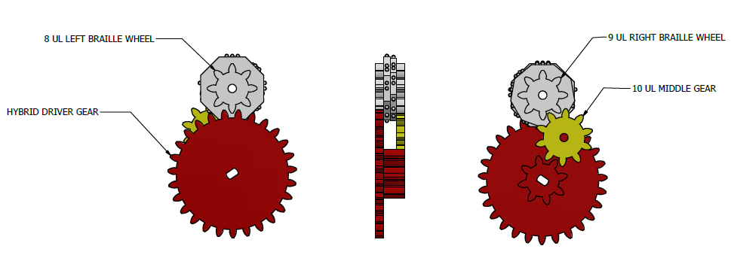
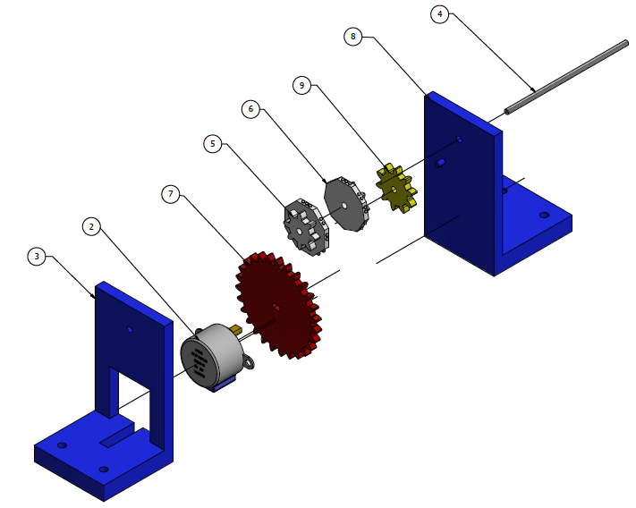
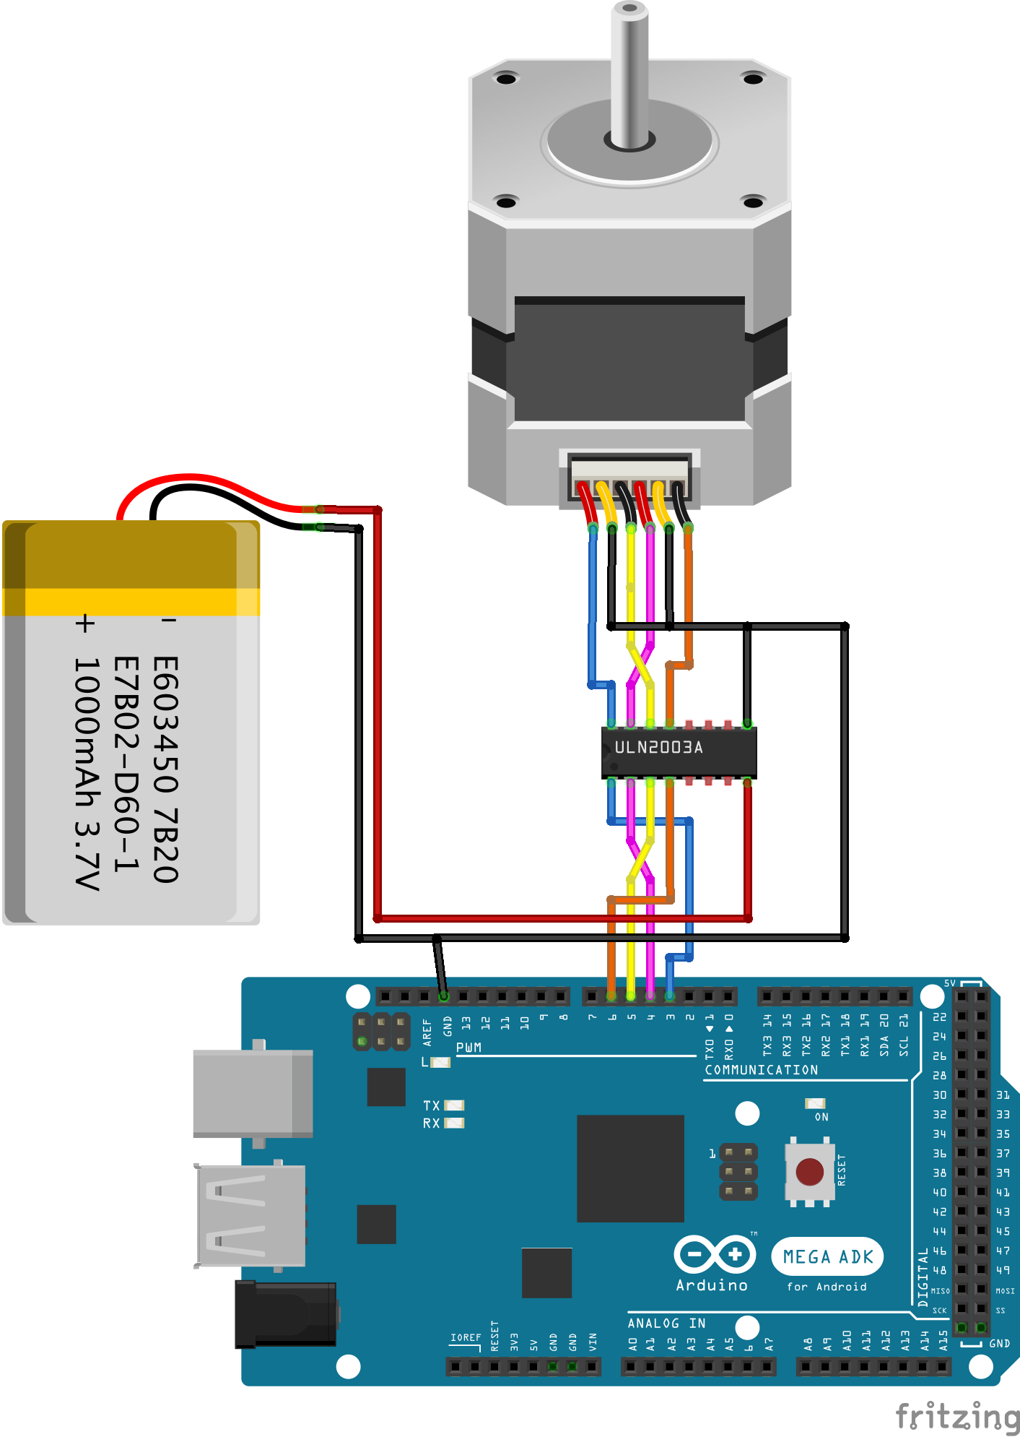
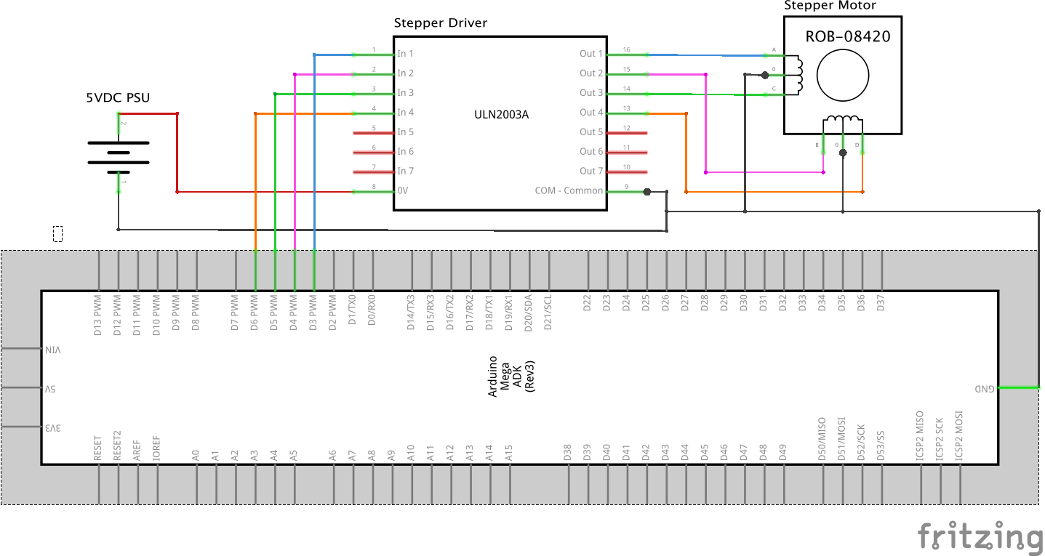
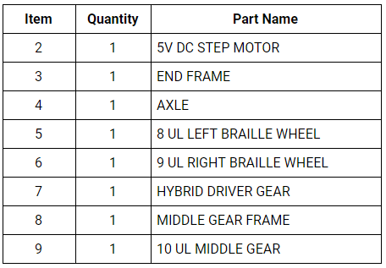
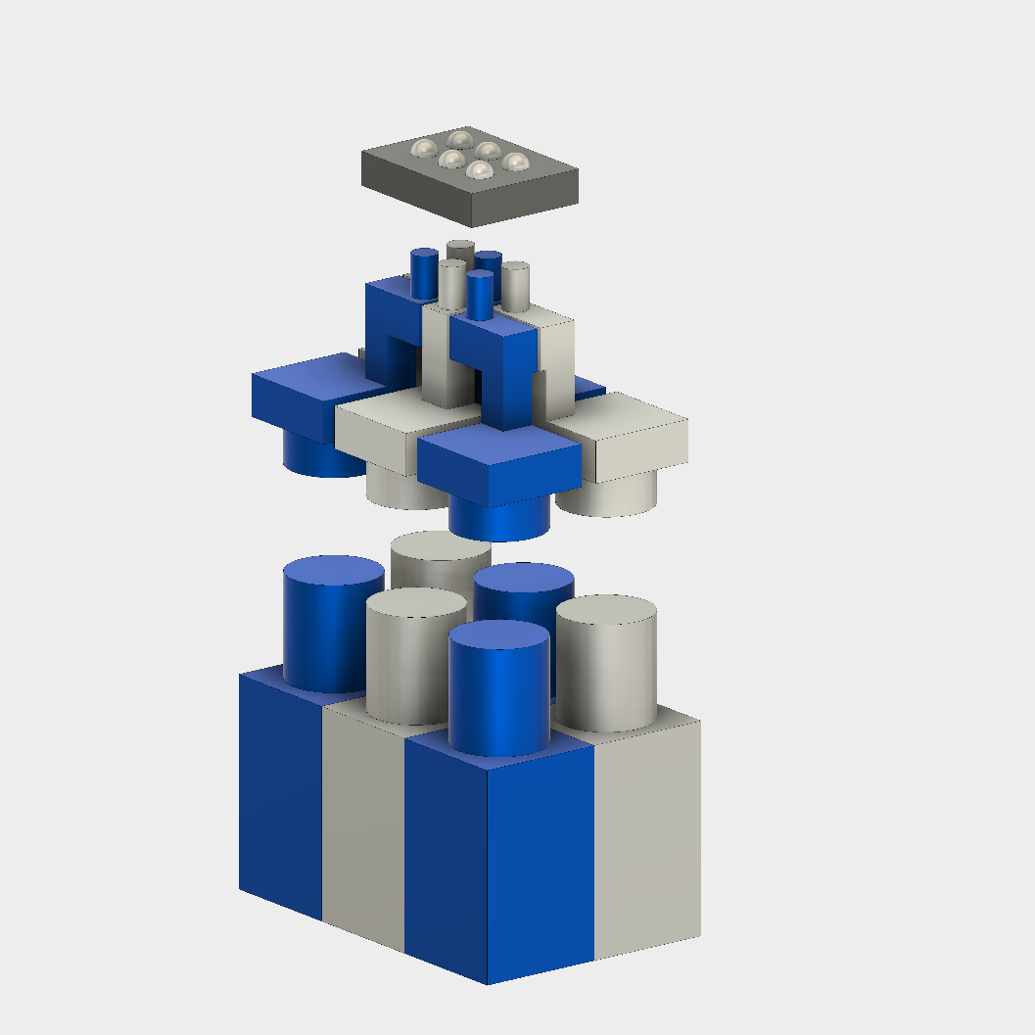
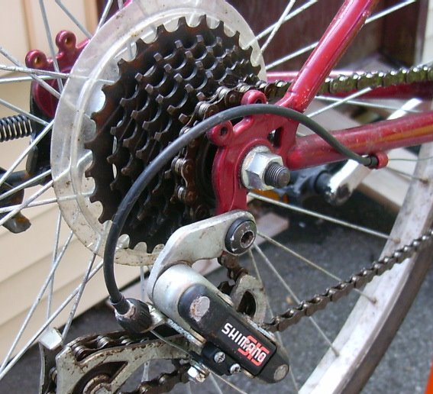
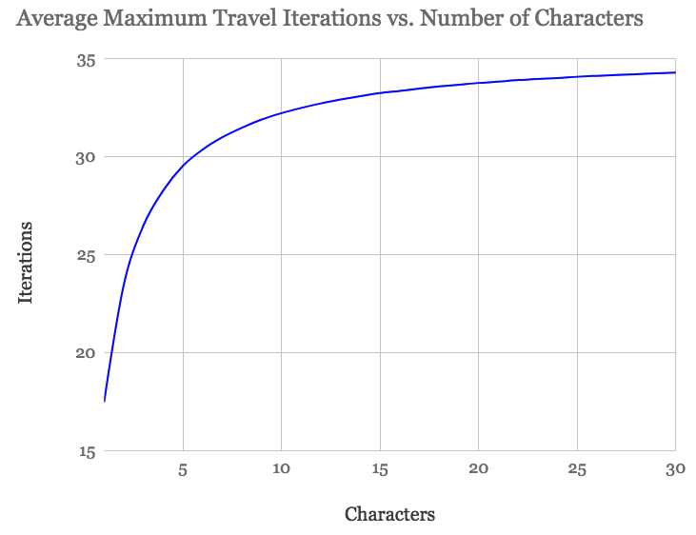
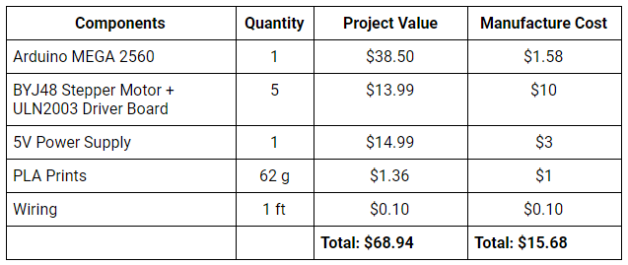
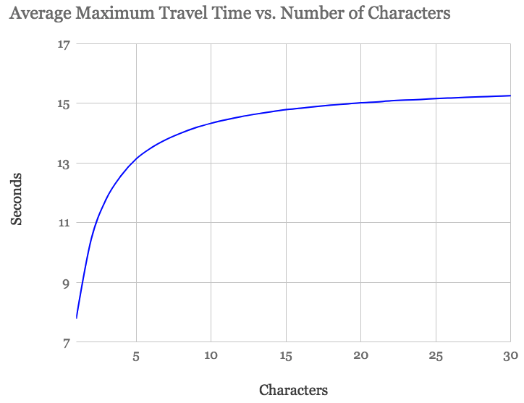
Open Refreshable Braille Display (ORBD)
Russell Ro, Adam Walker
Advanced Technologies Academy, Las Vegas NV 89106
Introduction
Hardware
Results and Discussion
285 million people are estimated to be visually impaired worldwide.
Non-institutionalized persons aged 21-64 years have median annual household income of $39,700 and about 29% of them live below the poverty line.
A refreshable braille display converts digital text to a tactile readout providing a valuable tool in reading and writing applications.
Prices range from $3,500 to $15,000.
Cheaper alternatives suffered from higher translation error rates due to restricted number of characters.
Open Refreshable Braille Display
Arduino microcontroller-based that takes digital input through serial and translates those characters to braille readout.
Accessibility: Budget set to approximately $100; will be released as an open-source device.
Education: Practical in educational settings through use of digital text translation (i.e. textbooks, homework, etc.).
Character Limitation: Doesn’t sacrifice on readability due to a character additive design.
The Open Refreshable Braille Display (ORBD) satisfies three objectives:
Accessibility: Comprised of easily-obtainable hardware that amounts to approximately $70 if built personally or as low as $15 if mass-produced.
Education: Successfully translates characters typed onto a computer to a stepper motor’s position which outputs braille characters; allows for an instructor to use as real-time educational tool (i.e. teaching braille characters).
Character Limitation: Utilizes an axle and 3D-printed parts, allowing the user to expand the amount of characters on their device; each additional character costs about $3 (includes stepper motor, driver, and 3D-printed parts).
The ‘Hybrid Driver Gear’ consists of two sets of gear: one with 27 teeth and one with 8 teeth. The 27-tooth gear drives the 8-tooth octagonal left braille wheel, while the 8-tooth gear drives the 8-tooth nonagonal right braille wheel with a 10-tooth middle gear in between.
ORBD is a gear-based stepper motor concept that uses one stepper motor per character. Since this design saves on costs as it uses one motor for the two braille wheels that comprise one character instead of two motors. In order to find the ideal gear ratios, we ran simulations and resulted in using an 8:27 gear ratio that runs octagonal and nonagonal braille wheels per character. The 8:27 was chosen for its reasonable tooth-proportions and lowest average iterations to get from one character to the next (17.5). However, this design resulted in more challenges compared to the simpler, more expensive concepts:
Extra gears made the device more prone to jams especially given that 3D printed parts aren’t perfect.
It takes longer to translate digital text to braille output due to the device having less motors.
Although ORBD has the additive character feature, each character is much bigger than current models’ character making for an inconveniently-sized braille display.
However, the benefits outweigh the drawbacks due to cost. The ORBD stands at an affordable $70 compared to the average price range of $3,500 to $15,000. With open-source access, ORBD has the potential to reach the millions of visually-impaired people who need it most.
Design Concepts
Gear Ratio Simulations
Solenoid-Based Concept: Each “bump” is raised using solenoids arranged in a 2x3 grid.
Pros:
Characters change near instantaneously
Cons:
Solenoids are too large & too many I/O pins to expand past a handful of characters.
Power is required at all times to keep characters.
Travel Times
To reduce costs and size, the left and right wheels are geared together. As it is necessary for the gears to maintain a flat surface at all times, the gear ratio must be such that all 64 combinations of characters* can be displayed accurately. A computer simulation was used to test the efficiency of various gear ratios.
Let L and R be the number of positions on the left and right wheels, respectively.
For every position moved forward on the right wheel, let n be the number of positions the left wheel moves such that 2 ≤ n < L.
When there are eight positions on each wheel (L = R = 8), there is no n that will display all 64 combinations.
Thus, we ran simulations that add “nothing” positions that don’t display characters:
For every left wheel size L such that 8 ≤ L < 25
For every right wheel size R such that 8 ≤ R < 25
For every ratio n such that 2 ≤ n < L
If every single position can be displayed, we log the mean and maximum number of iterations required (one iteration being moving one position forward on the slower wheel) to reach any character.
The simulation ran forwards only. These numbers can be cut in half by running motors backwards and forwards.
In addition, the true gear ratio that resulted was calculated and logged
* Each wheel is responsible for one column of three bumps with 2³=8 permutations. Thus, there are 8²=64 possible characters that can be displayed.
Based on the simulations, R = 9, L = 8, n = 3, and an 8:27 gear ratio was the most efficient (both in average time and in worst-case scenarios) and yielded the quickest travel times for a single character. As more characters are added, the travel iterations and travel times are logarithmic in shape and approach the values of 35 iterations and 15.575 seconds (@15RPM), respectively, as the number of characters approaches infinity.
In testing the responsiveness of changing characters, there is a negligible delay that averages 4ms, no matter the motor’s speed, as measured by the Arduino. Though the stepper motor’s top speed was approximately 20 RPM, all tests were conducted at 15 RPM to ensure the stepper motor did not lose steps.
Derailleur Concept: Similar to a bicycle changing gears, a mechanism allows switching between characters displayed on a single wheel of 8 combinations of bumps.
Pros:
Two motors required for a theoretically infinite number of characters.
Cons:
One wheel can be moved at a time.
The mechanism to switch wheels is complex, causing greater potential for jams.
http://www.howtofixbikes.ca/2006/07/adjusting-your-derailleur.html
Ave(Iter.) | Max(Iter.) | Slow Size R | Fast Size L | Pos Ratio n | Ave(R Revs) | Max(R Revs) | Ave(L Revs) | Max(L Revs) | Actual Gear Ratio
35 | 70 | 9 | 8 | 3 | 3.89 | 7.78 | 13.13 | 26.25 | 8:27
35 | 70 | 9 | 8 | 5 | 3.89 | 7.78 | 21.88 | 43.75 | 8:45
35 | 70 | 9 | 8 | 7 | 3.89 | 7.78 | 30.63 | 61.25 | 8:63
35 | 70 | 9 | 8 | 9 | 3.89 | 7.78 | 39.38 | 78.75 | 8:81
35 | 70 | 9 | 8 | 11 | 3.89 | 7.78 | 48.13 | 96.25 | 8:99
35 | 70 | 9 | 8 | 13 | 3.89 | 7.78 | 56.88 | 113.75 | 8:117
35 | 70 | 9 | 8 | 15 | 3.89 | 7.78 | 65.63 | 131.25 | 8:135
…
379 | 529 | 24 | 23 | 22 | 15.79 | 22.04 | 362.4 | 506 | 23:528
Conclusion
Gear-Based Stepper Motor Concepts: Wheels of 8 combinations of bumps (1 column of a character) are driven by stepper motors.
V1: One stepper motor per wheel (2 per character)
V2: One stepper motor per character & a 27:8 gear ratio connects the two wheels.
Pros:
Uses only one motor (V2) or two motors (V1) per wheel.
In V1, each motor travels at most half of a revolution. In V2, on average, the faster wheel travels 6.56 revolutions and the slower 1.94.
Allows characters to be placed next to each other as long as there are I/O pins.
All motors can be driven at the same time.
Cons:
Requires two stepper motors per character, resulting in greater cost and size. This may require more space between each character.
Each motor requires a stepper motor driver, and the power supply must be strong enough to drive every motor.
If the microcontroller loses power or the stepper loses steps, the device loses track of its position.
The Open Refreshable Braille Display is able to convert digital text into familiar braille text in a way that does not sacrifice readability. Its form factor is expandable, theoretically allowing for more characters than anything currently on the market. Most importantly, it could be manufactured for as little as one one-thousandth the cost of existing displays, removing any economic barrier. As an open-source alternative, ORBD will be able to revolutionize computer use, including for e-books and e-textbooks, for the visually impaired.
References
Vision impairment and blindness. (2017, October). Retrieved January 21, 2018, from http://www.who.int/mediacentre/factsheets/fs282/en/
Refreshable Braille Displays. (n.d.). Retrieved January 21, 2018, from http://www.afb.org/prodBrowseCatResults.aspx?CatID=43
Blindness Statistics. (n.d.). Retrieved January 21, 2018, from https://nfb.org/blindness-statistics
Russomanno, A., Omodhrain, S., Gillespie, R. B., & Rodger, M. W. (2015). Refreshing Refreshable Braille Displays. IEEE Transactions on Haptics,8(3), 287-297. doi:10.1109/toh.2015.2423492

